Slide 3
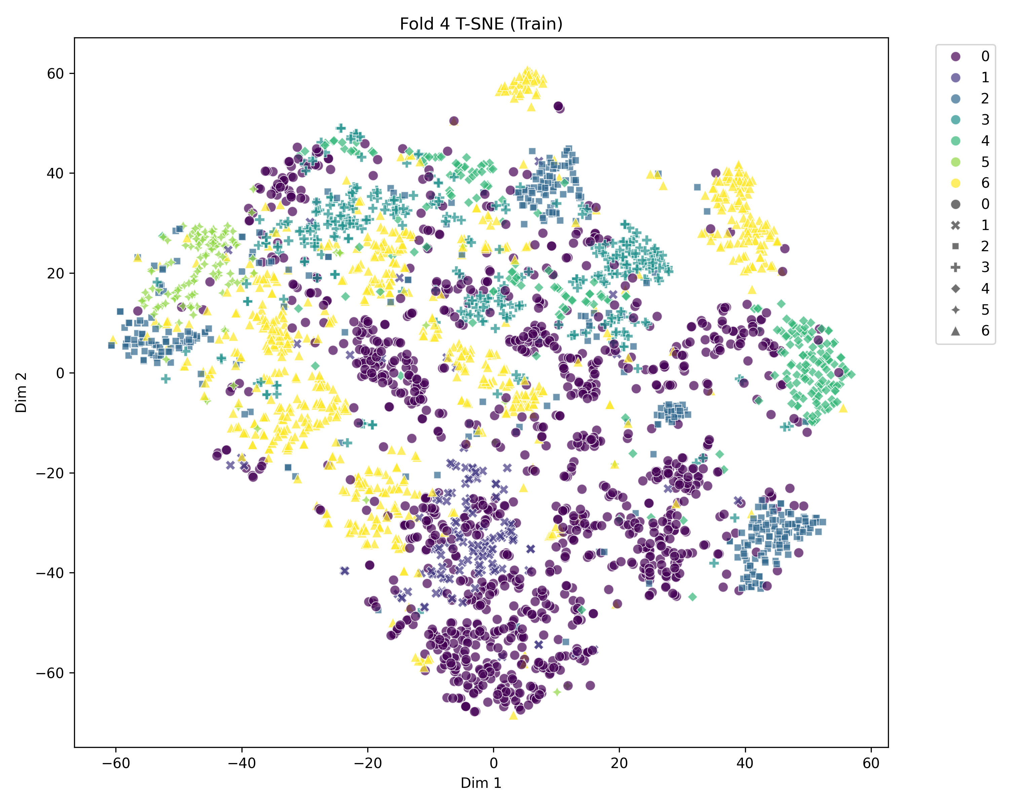
60
40
20
0
-20
-40
-60
-60
-40
-20
0
20
40
60

